Slide 1
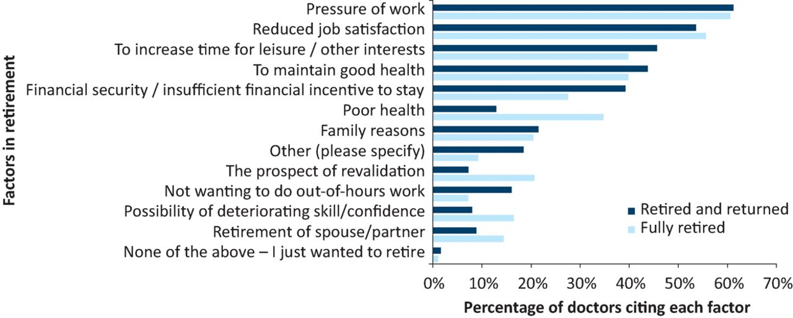

Reasons for retirement, comparing fully retired doctors with retired and returned doctors.
Fay Smith et al. Future Healthc J 2018;5:192-197
© Royal College of Physicians 2018. All rights reserved.
Notes:
Reasons for retirement, comparing fully retired doctors with retired and returned doctors.

